Slide 2
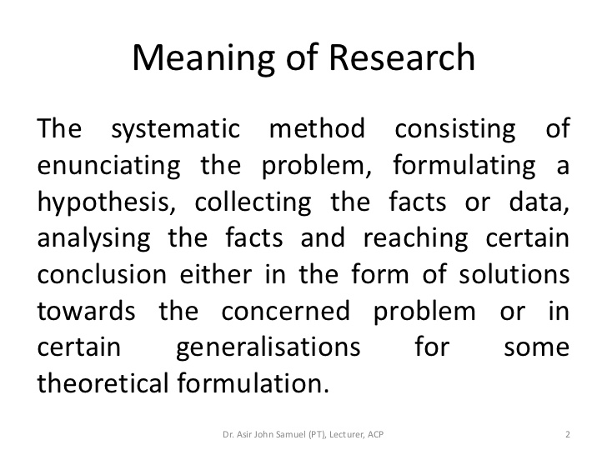

Slide 3
Research is an endeavour to discover answers to intellectual and practical problems through the application of scientific method.
“Research is a systematized effort to gain new knowledge”.
-Redman and Mory
Research is the systematic process of collecting and analyzing information (data) in order to increase our understanding of the phenomenon about which we are concerned or interested

Slide 4
Objectives of Research
The purpose of research is to discover answers through the application of scientific procedures.
The objectives are:
To gain familiarity with a phenomenon or to achieve new insights into it – Exploratory or Formulative Research.
To portray accurately the characteristics of a particular individual, situation or a group – Descriptive Research.
To determine the frequency with which something occurs or with which it is associated with something else – Diagnostic Research.
To test a hypothesis of a causal relationship between variables – Hypothesis-Testing Research.

Slide 5
CRITERIA OF A GOOD RESEARCH
Purpose clearly defined.
Research process detailed.
Research design thoroughly planned.
High ethical standards applied.
Limitations frankly revealed.
Adequate analysis for decision maker’s needs.
Findings presented unambiguously.
Conclusions justified.
Researcher’s experience reflected.

Slide 6
QUALITIES OF A GOOD RESEARCH
Systematic
Logical
Empirical
Replicable
Creative
Use of multiple methods

Slide 7
TYPES OF RESEARCH
Descriptive vs Analytical Research
Descriptive Research is a fact finding investigation which is aimed at describing the characteristics of individual, situation or a group (or) describing the state of affairs as it exists at present.
Analytical Research is primarily concerned with testing hypothesis and specifying and interpreting relationships, by analyzing the facts or information already available

Slide 8
Applied vs Fundamental Research
Applied Research or Action Research is carried out to find solution to a real life problem requiring an action or policy decision.
Fundamental Research which is also known as basic or pure research is undertaken for the sake of knowledge without any intention to apply it in practice.
It is undertaken out of intellectual curiosity and is not necessarily problem-oriented.

Slide 9
Quantitative vs Qualitative Research
Quantitative Research is employed for measuring the quantity or amount of a particular phenomena by the use of statistical analysis.
Qualitative Research is a non-quantitative type of analysis which is aimed at finding out the quality of a particular phenomenon.

Slide 10
Conceptual vs Empirical Research
Conceptual Research is generally used by philosophers and thinkers to develop new concepts or to reinterpret existing ones.
Empirical Research is a data based research which depends on experience or observation alone. It is aimed at coming up with conclusions without due regard for system and theory.

Slide 11
Some other types of research..
One-time Research – Research confined to a single time period.
Longitudinal Research – Research carried on over several time periods.
Diagnostic Research – It is also called clinical research which aims at identifying the causes of a problem, frequency with which it occurs and the possible solutions for it.
Exploratory Research – It is the preliminary study of an unfamiliar problem, about which the researcher has little or no knowledge. It is aimed to gain familiarity with the problem, to generate new ideas or to make a precise formulation of the problem. Hence it is also known as formulative research.

Slide 12
Experimental Research – It is designed to assess the effect of one particular variable on a phenomenon by keeping the other variables constant or controlled.
Historical Research – It is the study of past records and other information sources, with a view to find the origin and development of a phenomenon and to discover the trends in the past, inorder to understand the present and to anticipate the future

Slide 13
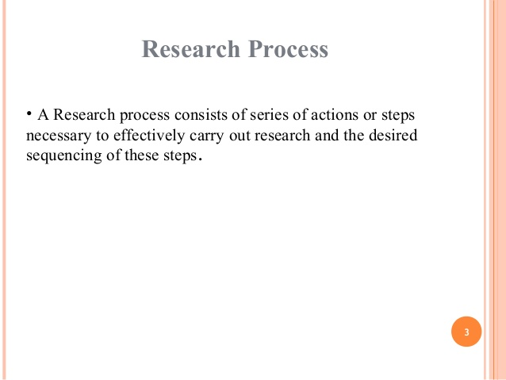

Slide 14
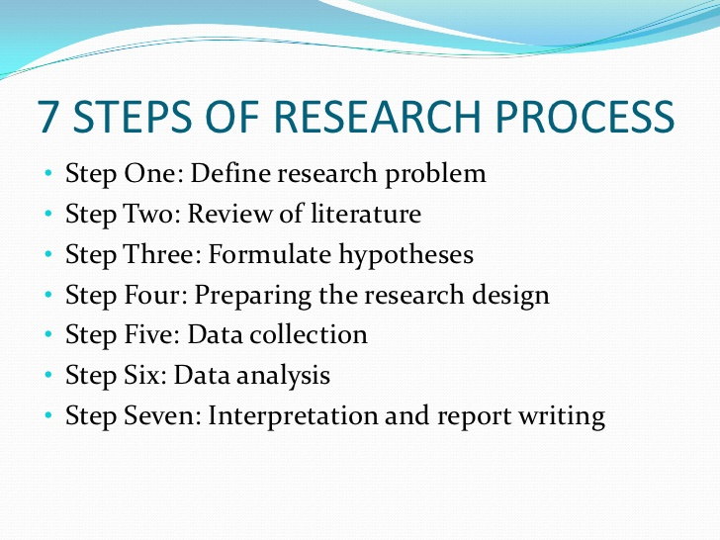

Slide 15
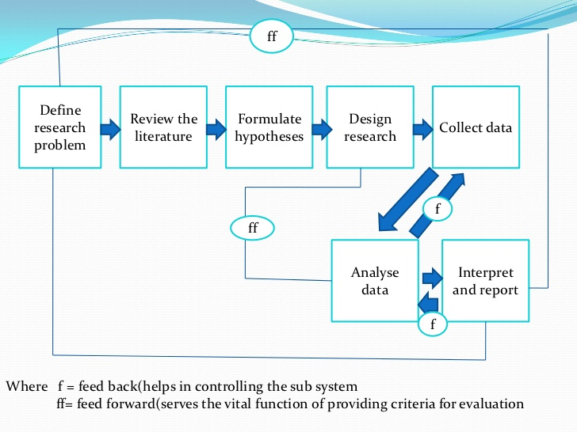

Slide 16
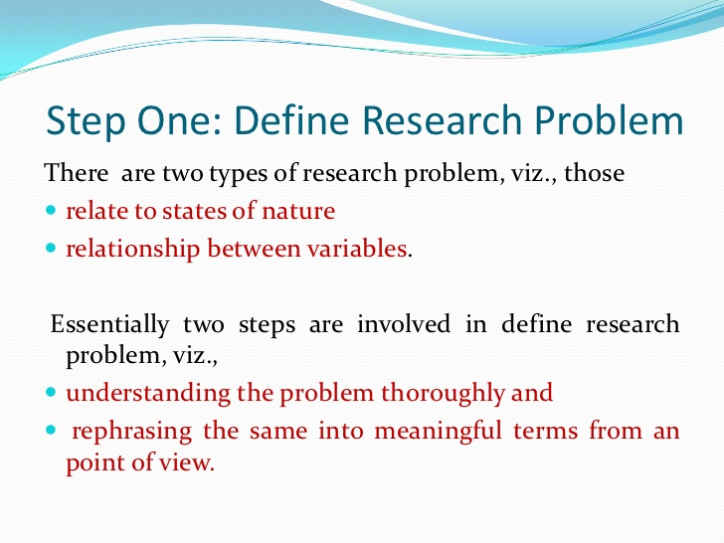

Slide 17
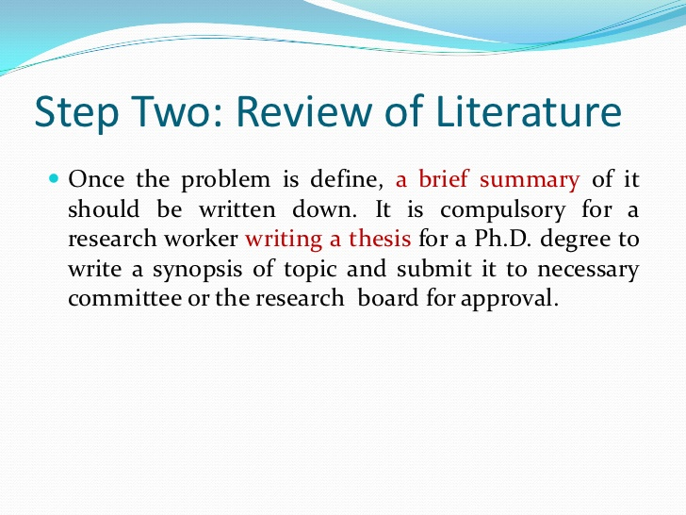

Slide 18
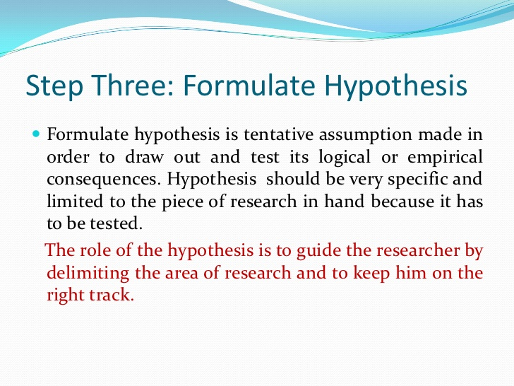

Slide 19
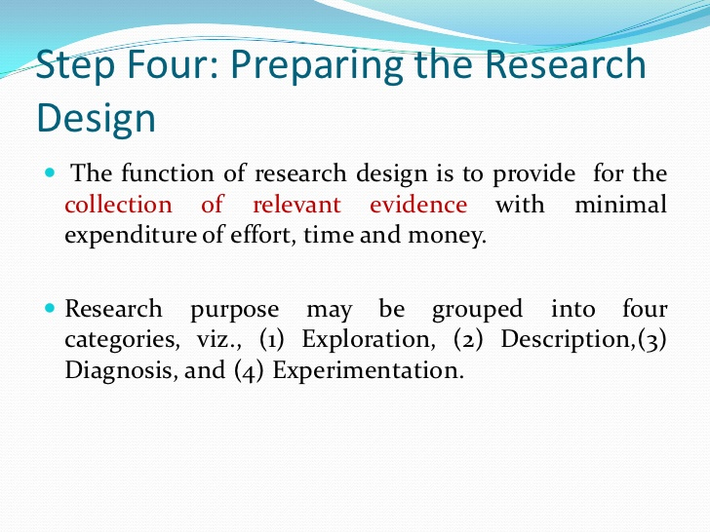

Slide 20
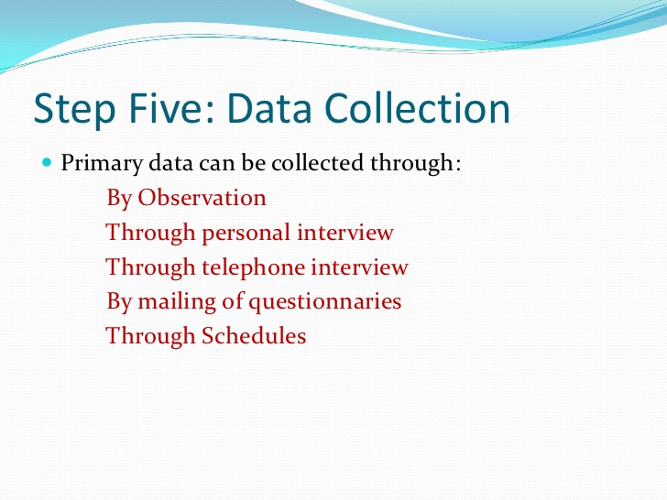

Slide 21
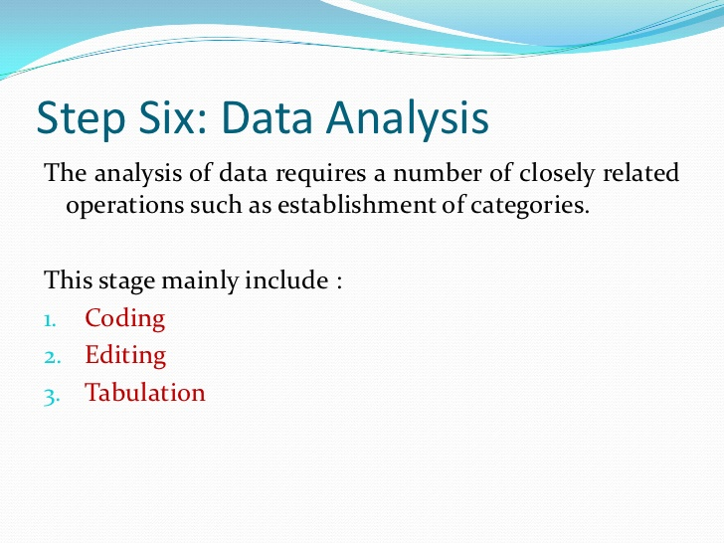

Slide 22
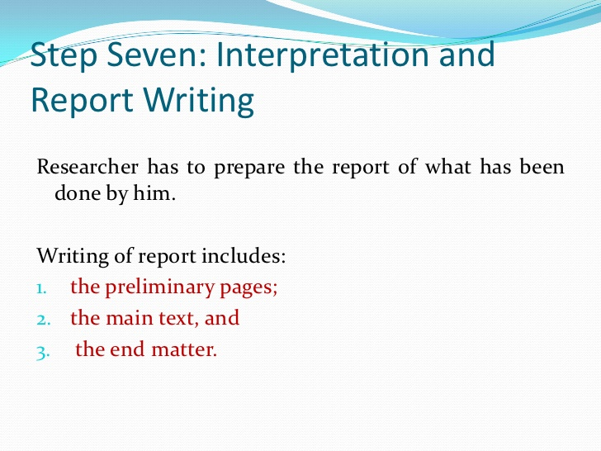

Slide 23
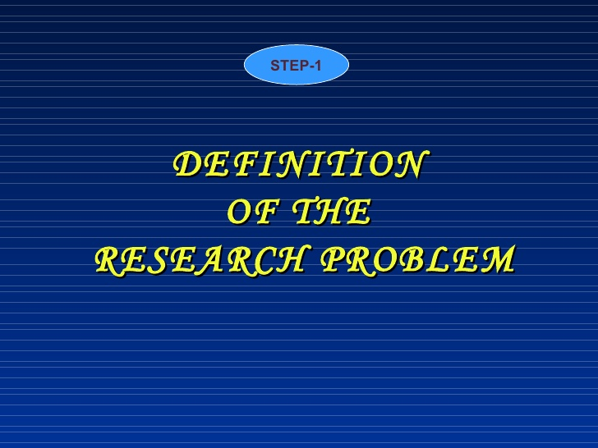

Slide 24
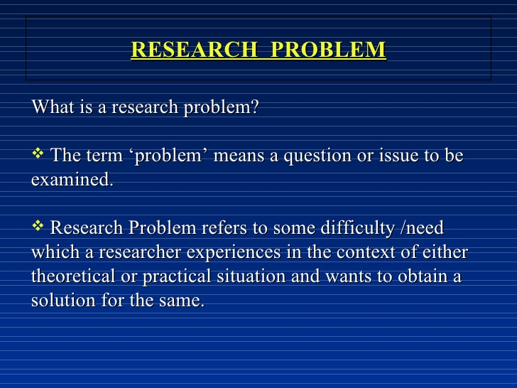

Slide 25
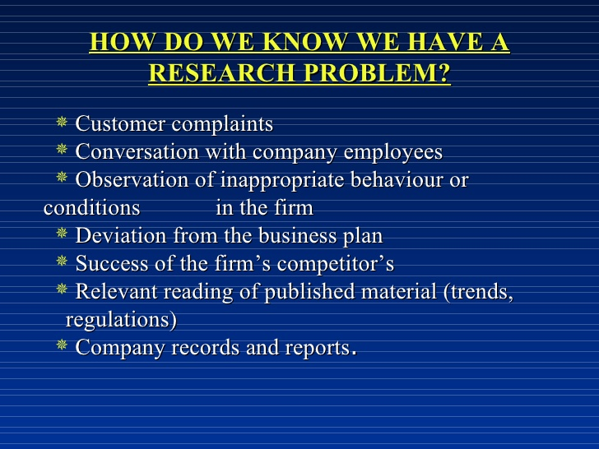

Slide 26
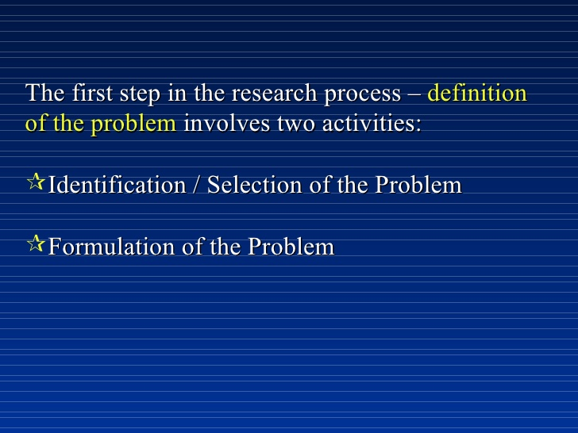

Slide 27
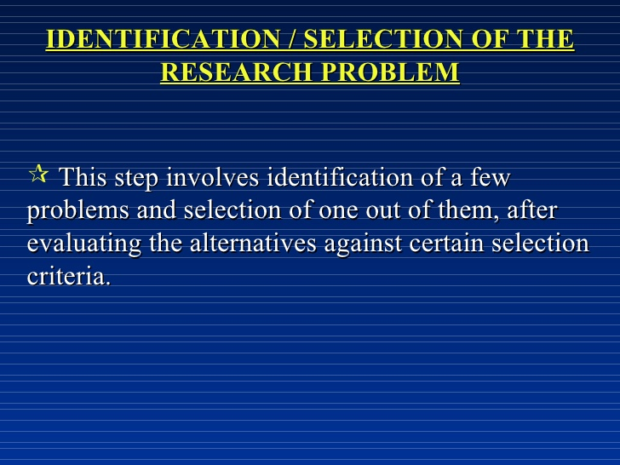

Slide 28
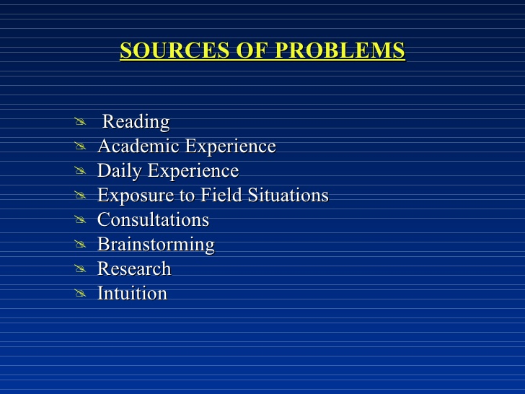

Slide 29
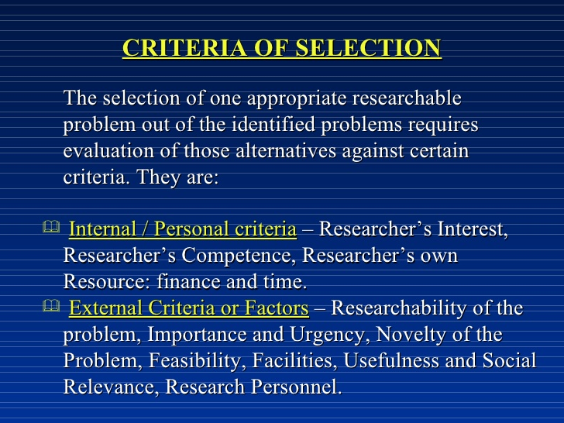

Slide 30
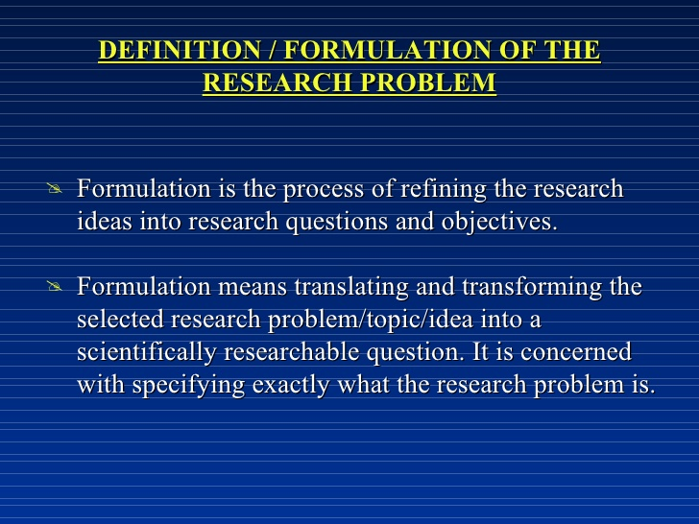

Slide 31
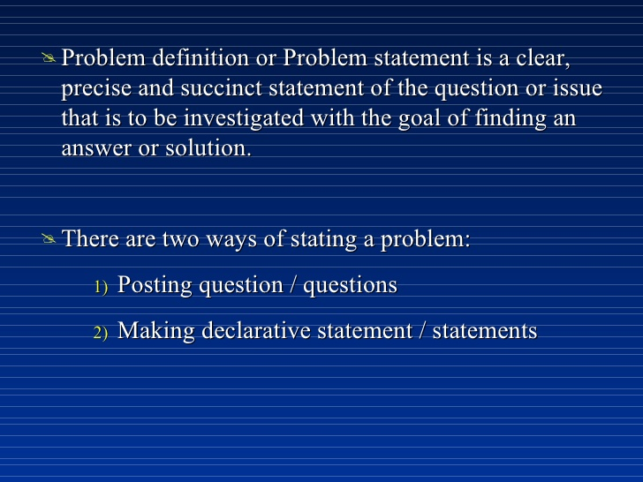

Slide 32


Slide 33


Slide 34


Slide 35
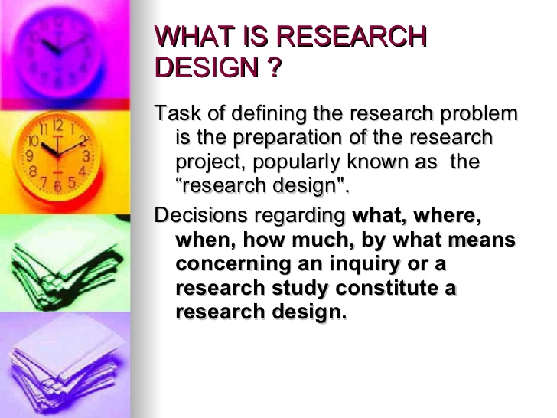

Slide 36
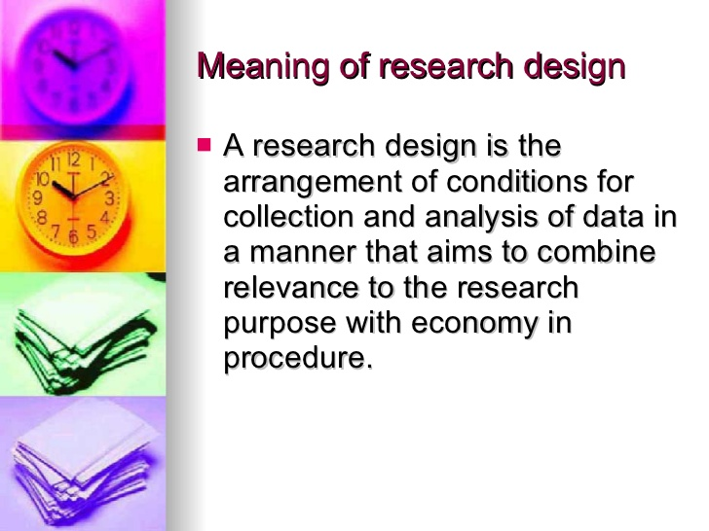

Slide 37
TYPES OF RESEARCH DESIGN

Slide 38
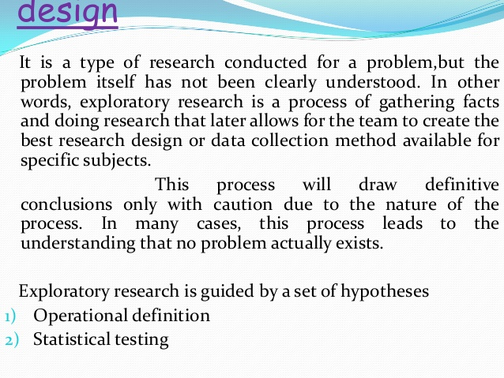

Slide 39
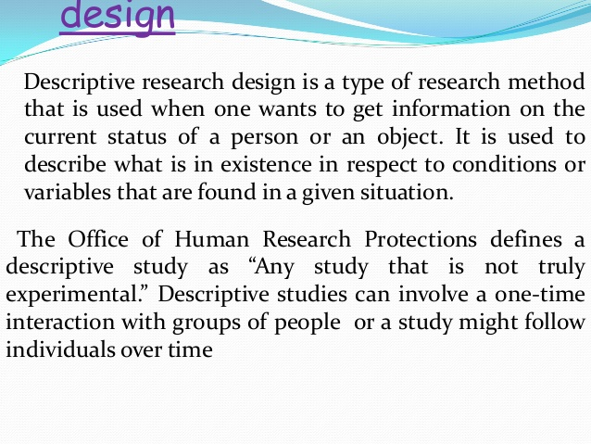

Slide 40
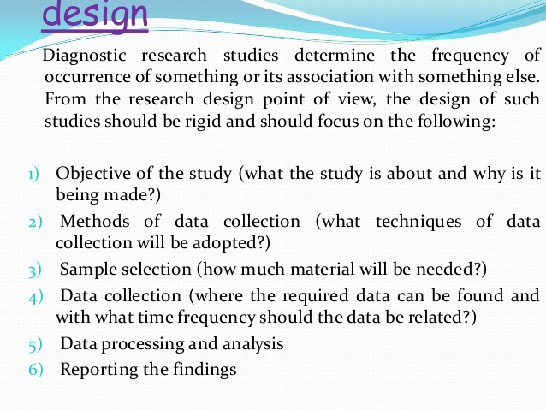

Slide 41
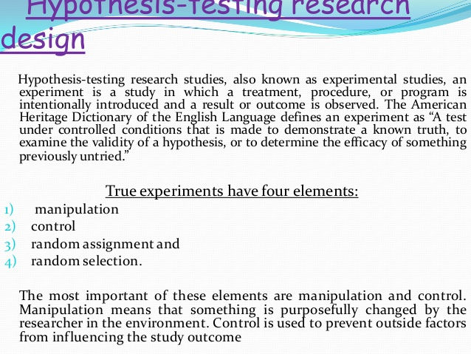

Slide 42
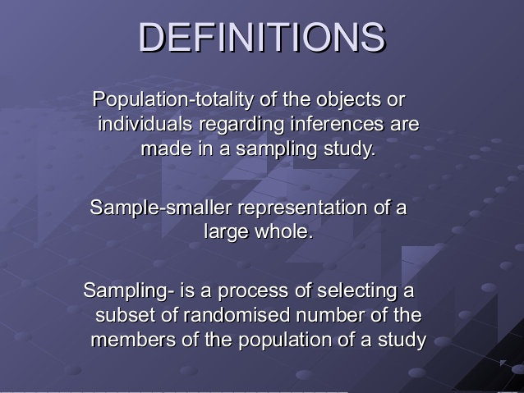

Slide 43
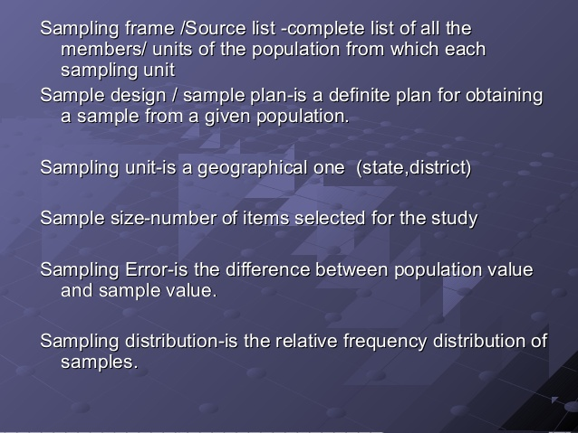

Slide 44
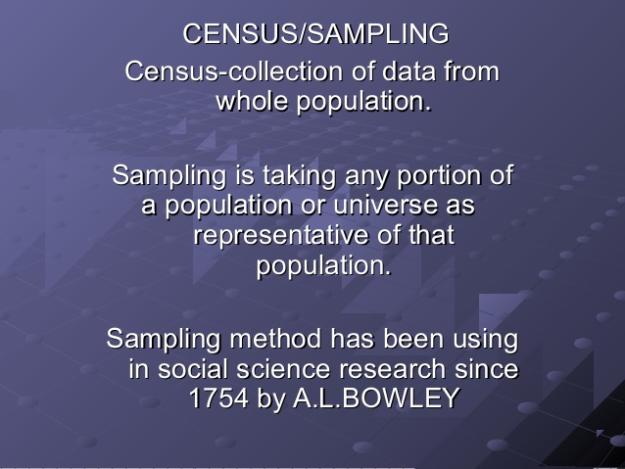

Slide 45
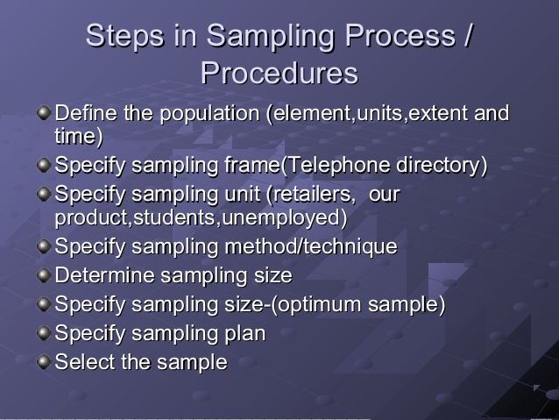

Slide 46
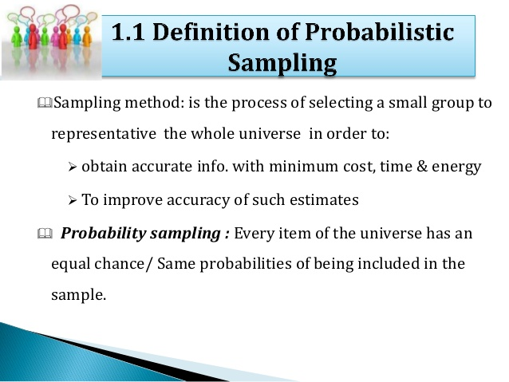

Slide 47
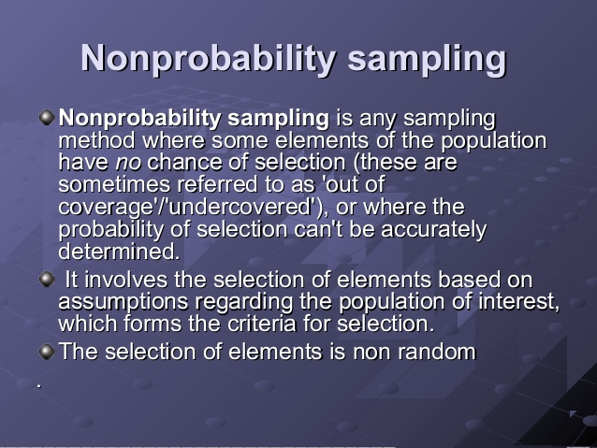

Slide 48
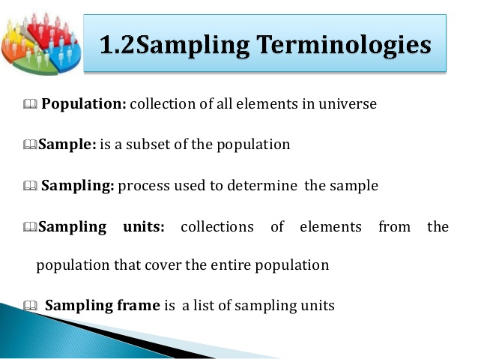

Slide 49
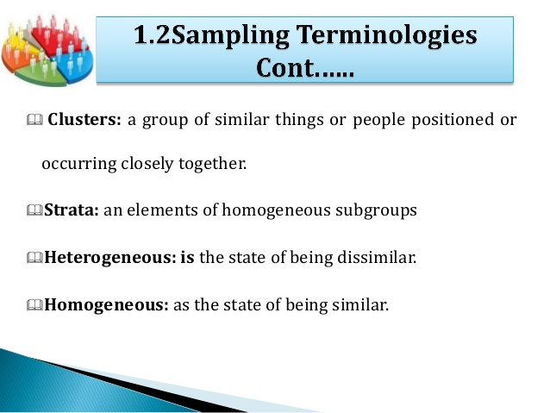

Slide 50
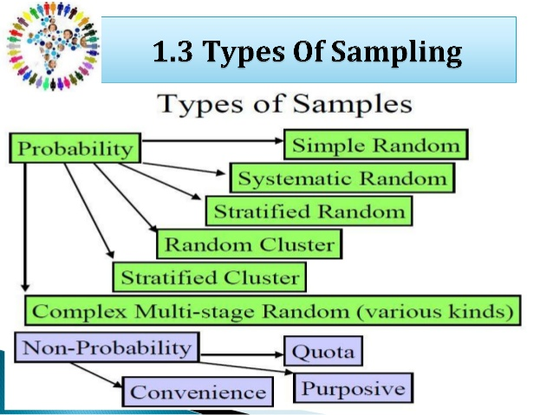

Slide 51
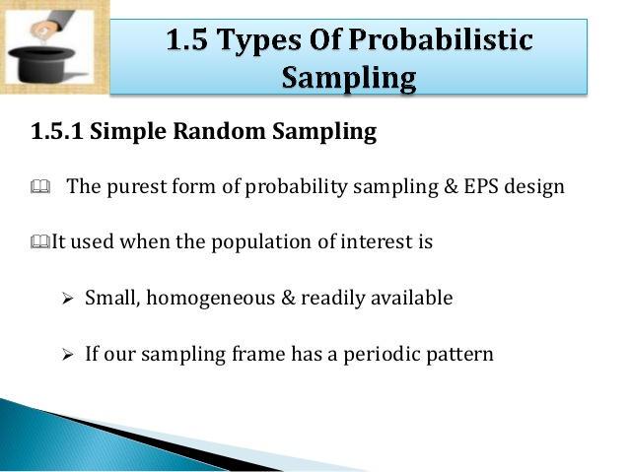

Slide 52
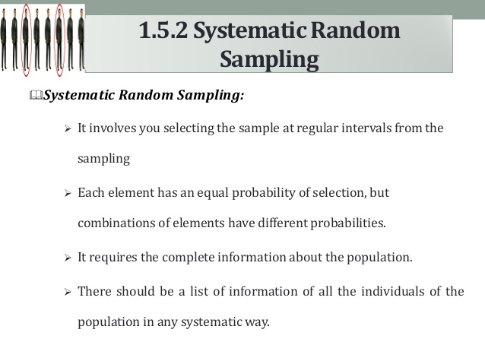

Slide 53
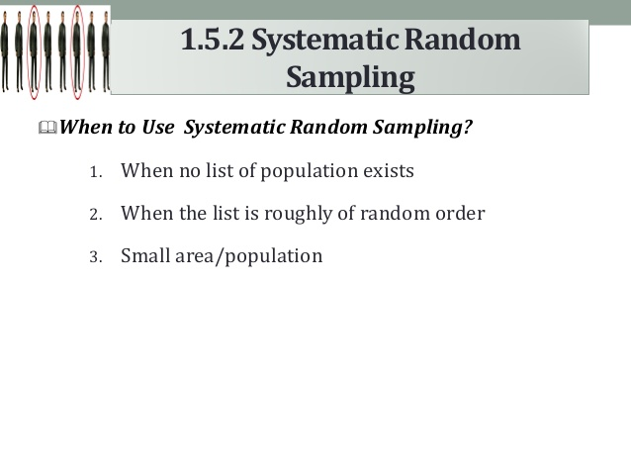

Slide 54
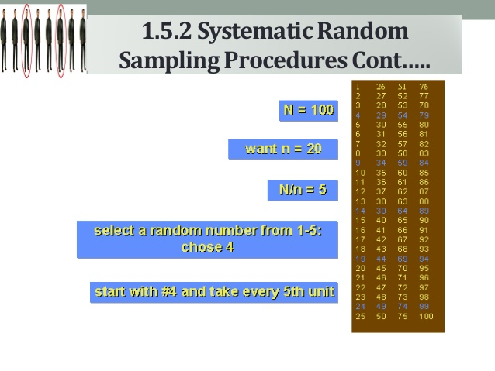

Slide 55
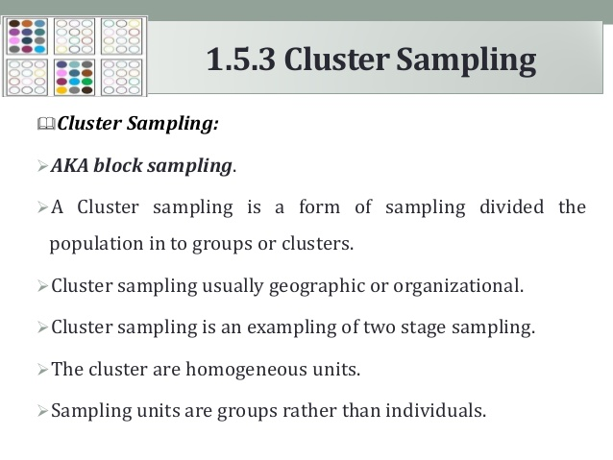

Slide 56
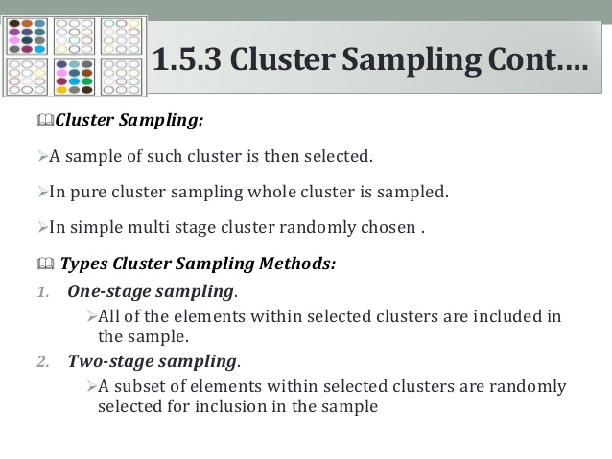

Slide 57
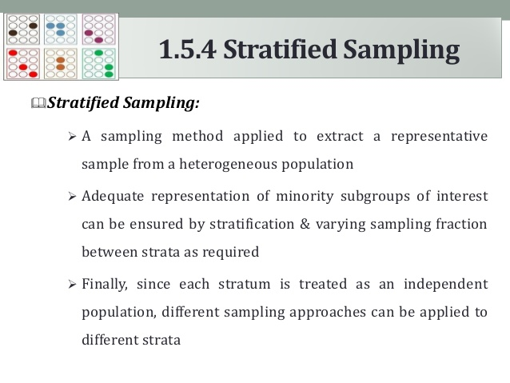

Slide 58
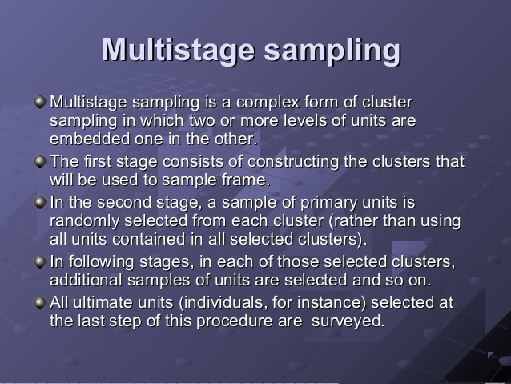

Slide 59
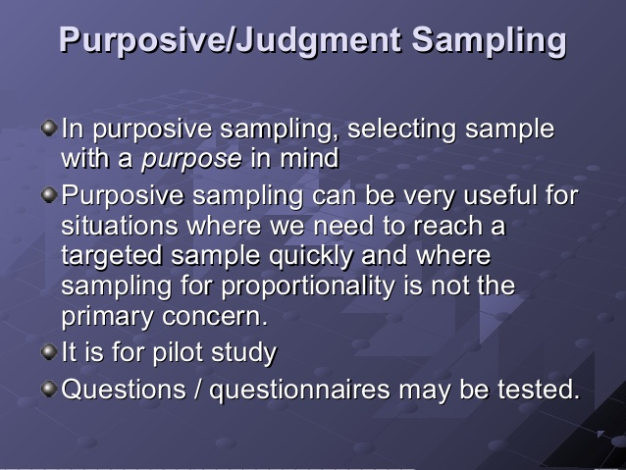

Slide 60
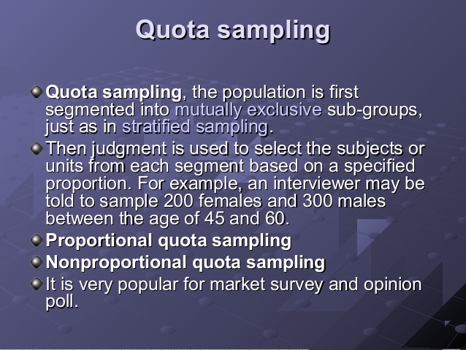

Slide 61
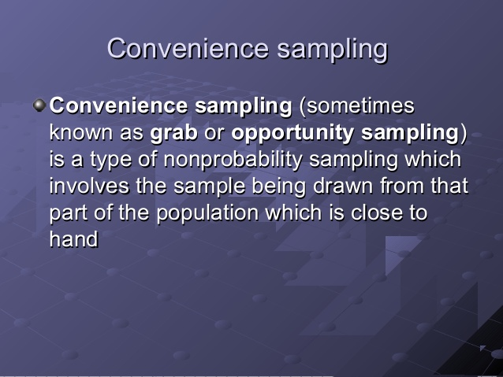

Slide 62
